Slide 1
RISK ANALYSIS Prepared by: Djeninah timothee
P

Slide 2
The problem
The problem is important for the customer because in order to have a loan there will have to be a guarantee the loan must be reliable and in the opposite case a loan without guarantee will reach a total loss and even the company will fail

Slide 3
Methodology
Plot the appropriate charts for the variables
Create worksheets with the charts
Create a final attractive Dashboard with the worksheets

Slide 4
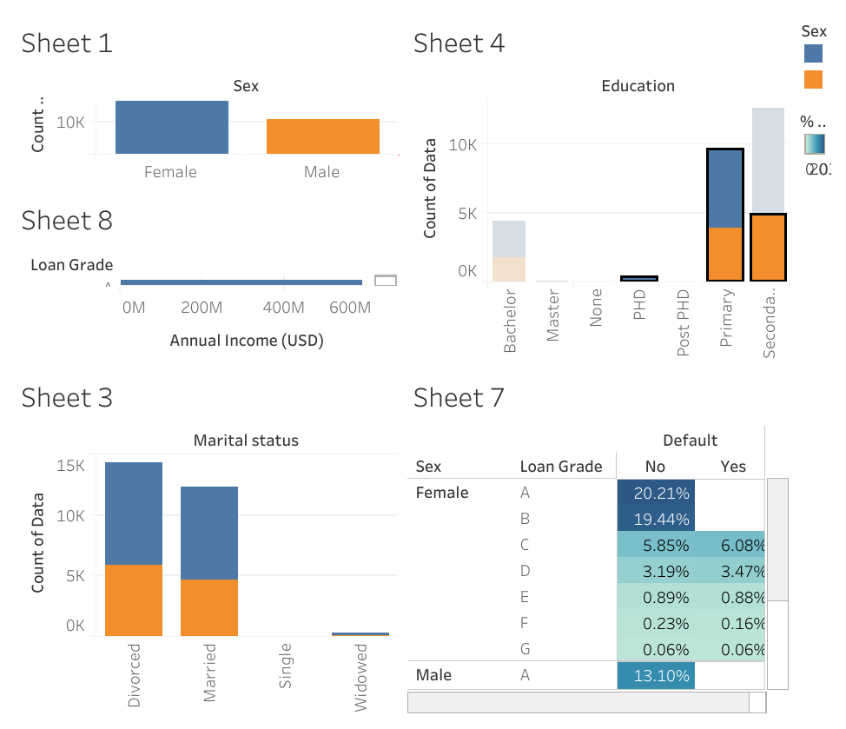

Slide 5
Discussion & proposal solution
Credit risk or "counterparty risk in financial markets" is defined as the probability of financial loss due to a borrower's failure to repay the debt issued by a financial institution when due
For a given transaction, the credit risk can be reduced by taking guarantees (sureties from a person or a surety company, collateral such as mortgages, etc.) but also by incorporating a margin in the interest rate, the value of which depends on the risk level.

Slide 6
Discussion & proposal solution
Beyond 10% the people have difficulties to pay for that it will be necessary to reduce the interest rate. because the bank needs its customers then it will be necessary to work on it

Slide 7
Discussion & proposal solution
I was able to see the people who are in the G grade I could see that the interest rates are much too high and while they can not afford. it will have to reduce their interest rate and increase those who have the ability to pay

Slide 8
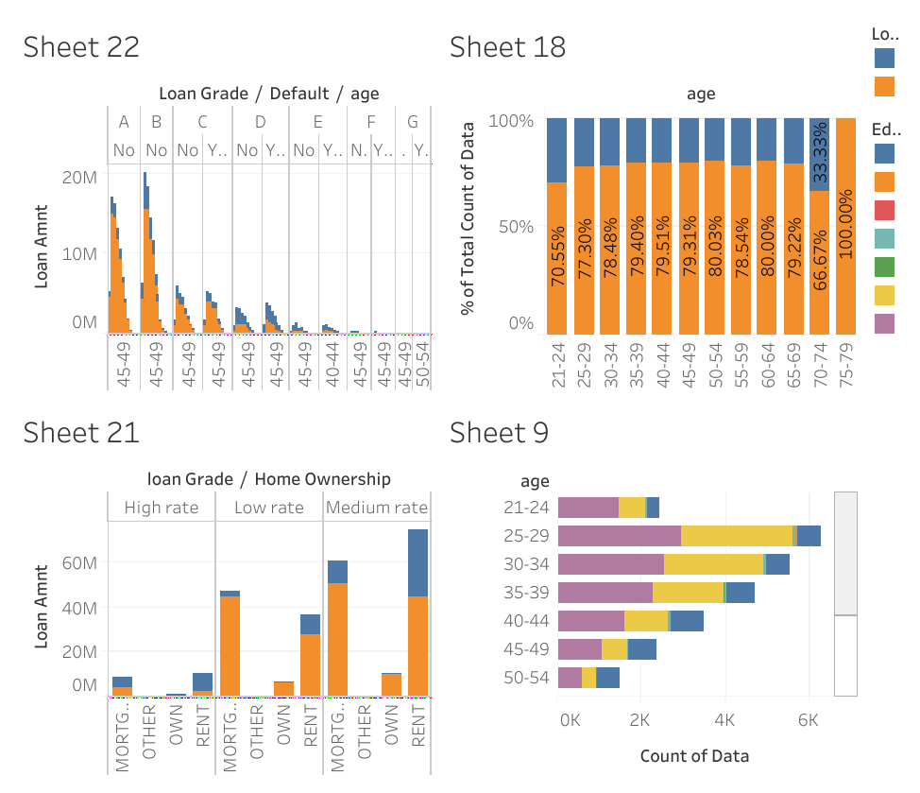

Slide 9
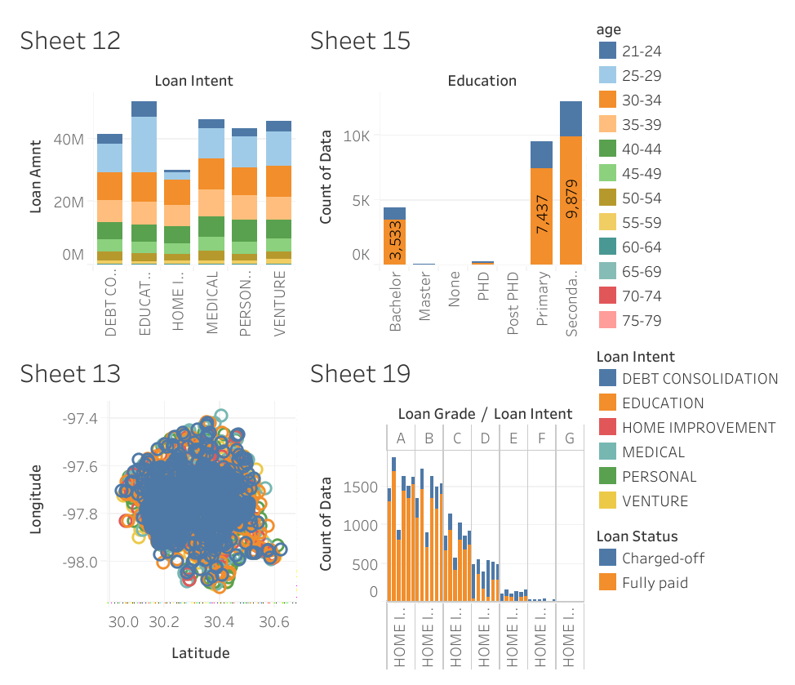

Slide 10
Recommandations

